Slide 1
Getting Started with LLMs and Agents
Notes:
Hey everyone, thanks for being here."
"I know you’re probably hearing the words 'LLMs' and 'Agents' all over the place — ChatGPT this, AI that... and you might be wondering: where do I even begin?"
"That’s exactly what this session is for — we’re going to strip it down, build things step-by-step, and by the end of this, you’ll not only understand what LLMs and Agents are — you’ll see how easy it is to actually build one yourself.
Let’s dive in.
This is our focus for the next 30–45 minutes. We’re not going super deep into theory — but we are going deep enough that you can leave here and start building.

Slide 2
Table of Contents
3
What are LLMs ?
4
Meet the LLM
5
Prompt Roles
7
Prompting Techniques
11
Let’s Build a Chatbot!
14
What are Agents ?
Notes:
Here’s what our journey looks like."
"We’ll start with a quick story of what are llms and how we even got to LLMs. Then we’ll meet a local LLM.
We will then control it’s behavior and
Then we’ll build a chatbot —
and make it smarter step-by-step until it becomes something more than just a chatbot:
it becomes an agent
"By the end, you’ll have the mental model and some code patterns to go further on your own."

Slide 3

What are LLMs?
Text prediction machines (like ChatGPT)
Transformers Architecture
Notes:
Large Lanugage Models
Trained on so so so so much data
Trained for hours and hours
Who here has heard of transformers? I am talking about models not the movies guys…
"Imagine teaching a child to write a sentence by only showing them the previous word. You say 'The', and the child tries to guess what comes next. Maybe they say 'cat'. Then you say, 'The cat', and they try the next word. 'sat' maybe. It kind of works. But it’s limited, right? They don't know the full sentence or where it’s going — they just guess based on what they just saw."
🕰️ Early Days – Predicting One Word at a Time
"That’s how early models worked. We fed them words one by one, and they predicted the next one based only on a very short memory — like trying to finish a sentence while forgetting what was said just a few words ago."
🧠 Then Came LSTMs – A Better Short-Term Memory
"Then came LSTMs — Long Short-Term Memory networks. These were a big deal! They gave models a better memory of what came before. Now the model could remember a bit more context — maybe the whole sentence. It was like giving the child a notepad to jot down important parts of the conversation."
"But still, it was slow. Sequential. Word by word. And sometimes, it forgot things it really shouldn’t have."
🚀 2017 – The Breakthrough Year
"And then… came the breakthrough. In 2017, a team at Google published a paper with a bold title: 'Attention Is All You Need.' And they meant it. They introduced something called Transformers — a new kind of architecture that could read an entire sentence, paragraph, or even a book all at once, and figure out which words mattered most."
"No more going one word at a time. It was like giving our model the superpower to pay attention to everything, everywhere, all at once." 😄
🌟 This Gave Birth to LLMs
"That was the moment everything changed. Transformers became the backbone of today’s large language models — models like GPT, BERT, and many more."
"And from there, the idea grew: what if we trained a transformer on all the text on the internet? What if we scaled it up massively? That’s how we got to LLMs — Large Language Models — the text prediction engines like ChatGPT that we use today."

Slide 4
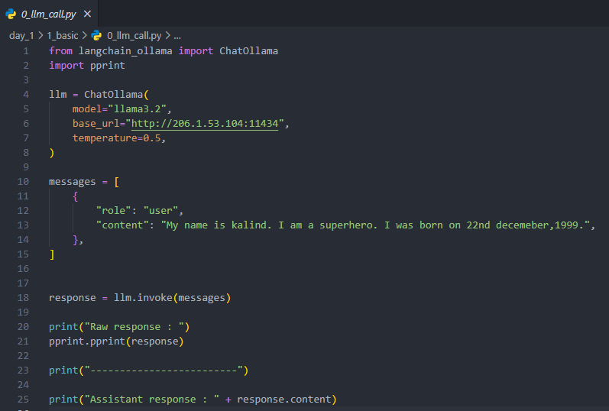
Let’s meet the LLM
Using :
LangChain :
Toolkit to help apps talk to AI models
Ollama :
A local AI model runner
Notes:
Ollama Installation - https://ollama.com/
So we just talked about what LLMs are. Now… let’s meet one."
"Not a theoretical model — a real one, running on my machine."
LangChain
Say: "LangChain is like the middleware or glue that helps apps — like the one we’re about to see — talk to LLMs. It abstracts away the boilerplate so you can focus on what the AI says, not how to wire it all together."
💻 Ollama
Say: "Ollama is a tool that lets you run open-source AI models locally. That’s right — no need to use OpenAI or go online. I can have my own private AI running on my machine." "It’s incredibly simple to install and use."
SPEND TIME AROUND Ollama installation on windows and ubuntu.
"So we saw how we can change model behavior using temperature. But that’s just one of many knobs."
"There are other parameters like top_p, top_k, frequency_penalty, etc., that give you even more control over how the model thinks — but I’ll leave those for you to explore later."
Now here’s something deeper to think about: How do we control the output? How do we actually guide the model to follow our instructions reliably?"

Slide 5
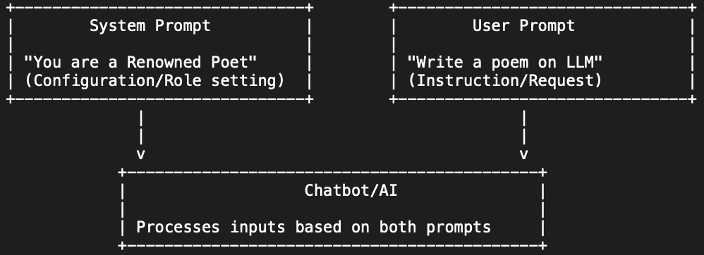
Prompt Roles
🧠 System Message: Sets behavior
🗣️ User Message: Asks question
🤖 Assistant Message: The response
Notes:
This is how modern LLMs — like ChatGPT and your local Ollama models — are structured behind the scenes. You’re not just sending one big prompt. You’re sending a sequence of messages, and each has a role."
"And just like that, the model knows it’s supposed to be a translator — not because the user asked, but because the system message told it how to behave
So to recap: controlling an LLM isn't just about what you say — it’s about how you say it, and in what role."
"System messages give you control over personality, style, tone, and behavior — and are the foundation for building smart, consistent AI agents.
Let’s try that for a bit shall we… let’s give persona… and a name.

Slide 6
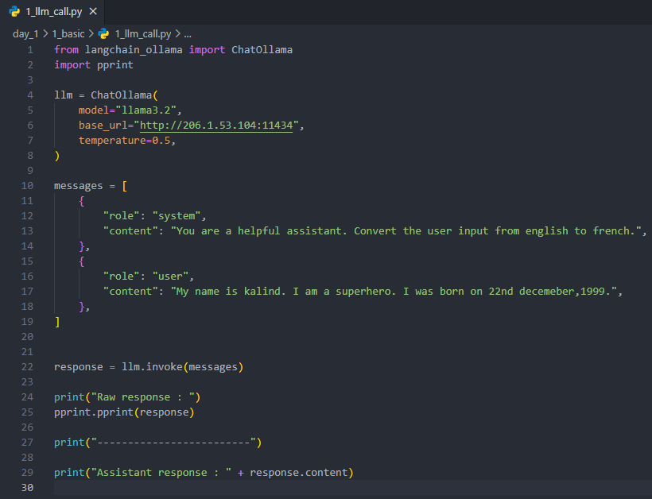
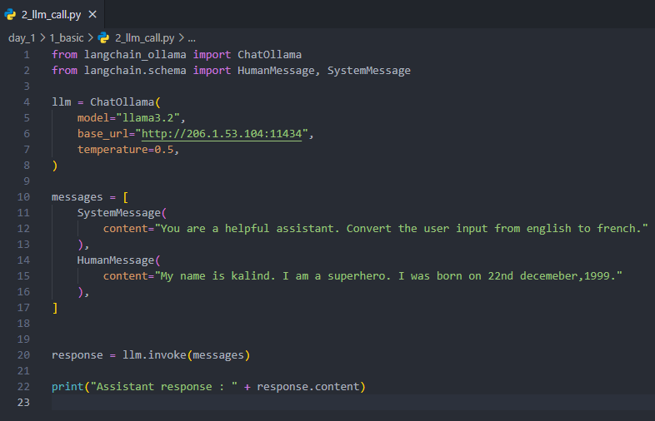
Two Ways
Notes:
We’ve seen how system prompts can shape behavior. But when you want an LLM to consistently act a certain way — especially in more complex apps or agent systems — that’s where prompt engineering comes in..
Prompt engineering is like UX design — but for AI. You’re not designing buttons; you’re designing thought patterns.
How you frame a prompt can make the difference between a genius answer and a total failure.

Slide 7
Prompting Techniques
❓ Zero-Shot - Just ask!
🧱 GAIL Method - Goal, Action, Instructions and Language
🧪 Few-Shot - Show Examples
Notes:
Let’s explore the main techniques that help you control output, tone, and behavior.
So why does this matter? Because prompting isn’t just a trick — it’s becoming a full-blown discipline." "In fact, companies are hiring Prompt Engineers to shape how their models respond." "Prompting gives you a way to 'program' AI without code — it’s like soft logic, written in natural language."
"And when you combine good prompting with system roles and LangChain… you’re not just asking questions — you're building intelligent behaviors.

Slide 8
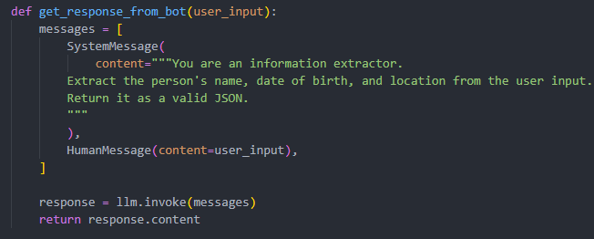
Zero-Shot Prompt Example
The model guesses based on training.
Often surprisingly accurate even without examples.

Slide 9
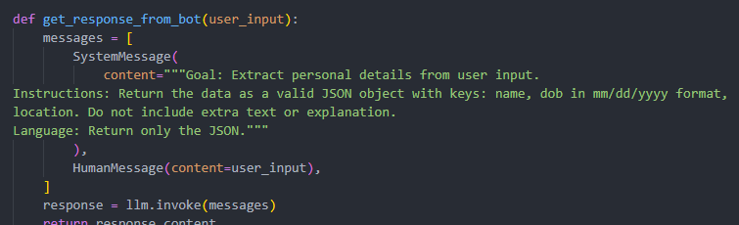
GAIL Methodology :
🎯 Goal : What is the task or outcome?
🛠️ Actions/Tools : What steps or tools can be used to achieve the goal?
📚 Information : User conversation so far or context for relevance.
🗣️ Language : What tone, style, or format is best?

Slide 10
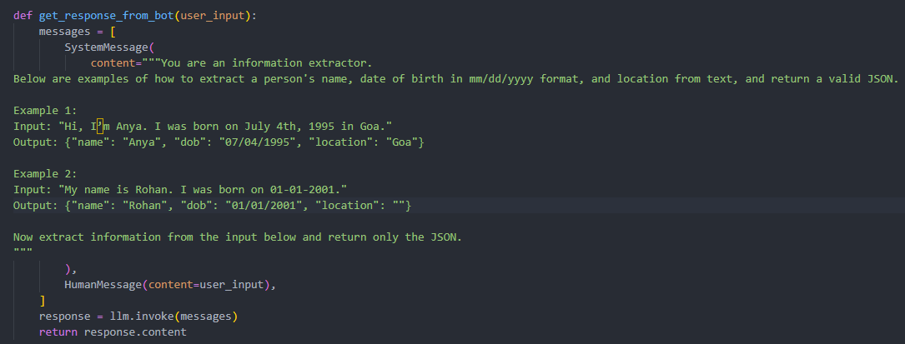
Few-Shot Prompt Example
By showing examples, we help the model generalize better.
Can reduce hallucinations.

Slide 11

Let’s Build a Chatbot!

Slide 12
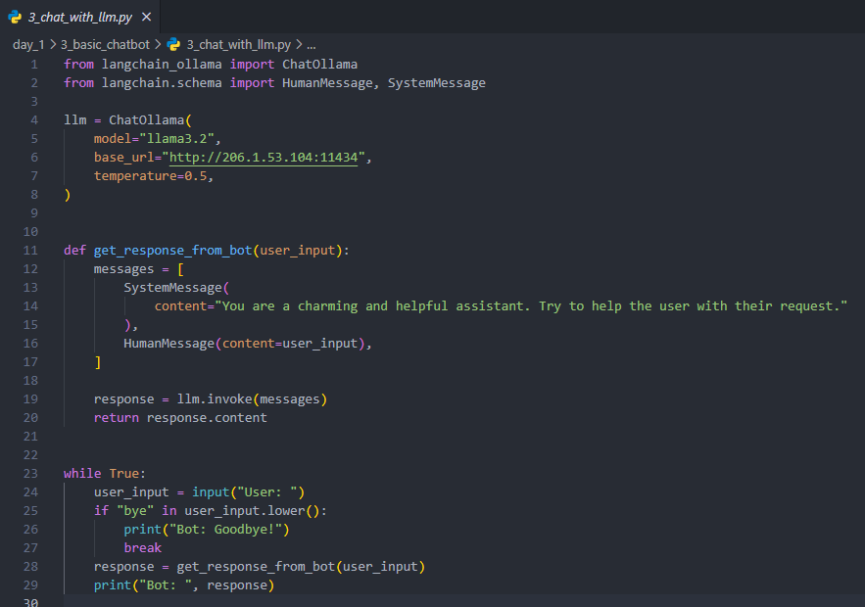
Step 1 : Simple Loop
Notes:
So far, we’ve been sending single messages. But real conversations need a loop — a way to keep chatting until the user wants to leave. Let’s do that.
"Hmm... did you notice something strange?"
"Why do you think the bot didn’t remember what I just said?"
Okay, so if we wanted our chatbot to remember things we've already told it — like a real assistant would — what do you think we’d need to change?
What if instead of sending just the latest user input, we sent the whole conversation to the model each time?

Slide 13
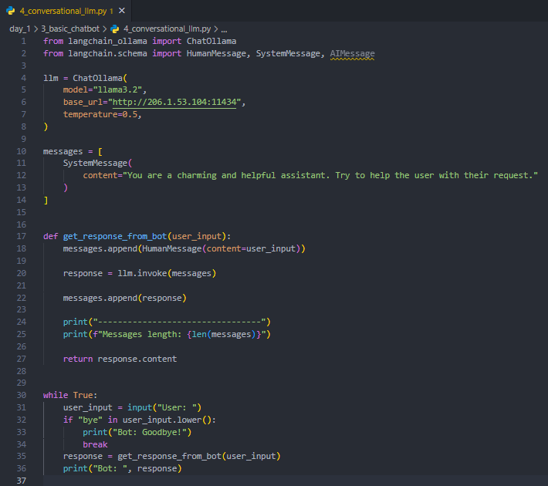
Step 2 : Add Conversation Memory
Maintain message list
Append every user + assistant message
Notes:
Exactly. That’s what we do in Step 2 — we keep a list of all messages, including the model’s own replies, and send it along each time."
"Let me show you how simple that is.
Boom. Context-aware assistant, just by maintaining a list.
The model itself is still stateless — it doesn’t remember anything by default."
"We give it memory by sending all past messages — we are its brain.
What else could we do with this memory? Could we summarize it? Save it to a file? Clear it halfway through?

Slide 14

What are Agents?
LLMs with memory, tools, and goals
They reason, act and adapt automatically.
Notes:
So far, we’ve built a chatbot that can remember things and hold a conversation. Pretty cool, right?
Now imagine if we wanted to go a bit further…
What if we wanted the chatbot to do something — like look something up on the internet, fetch weather, do math, or even send an email?
Exactly. But the LLM itself doesn’t know how to do that. It's like a smart brain with no hands."
"So how do we give it hands?
We need to give it tools.
But it also needs to know when and why to use them, right?
And that’s what an Agent is.
Not just a chatbot. Not just a model that replies. An Agent is an LLM with memory, tools, and goals — capable of acting on its own

Slide 15

🔧 Understand what tools are and why LLMs need them
⚙️ Learn how to register tools and integrate them with agents
🧠 Build a ReAct agent that decides when to answer or act
🧪 Add your own tools
💡 Discover how agents combine reasoning with action
Notes:
Now that you've met LLMs and Agents, here’s where it gets really exciting… If you had an AI Agent right now, what would you want it to do for you?
Those are perfect use cases. And the best part? With LangChain and tools, you can build those agents yourself.
Agents are not just answering questions.
They’re deciding what actions to take to help you reach your goal. That’s where AI becomes truly useful.

Slide 16
Questions?
Notes:
Alright, I’ll pause here — what questions do you have? What ideas are you curious about? What would you want to build?

Slide 17
Knowledge Check
->
What does “System Message” do in a prompt?
->
Which prompting method involves giving examples?
->
What are Agents in the context of LLMs?
->
What’s one thing we added to turn our LLM into a chatbot?

Slide 18
End of Chapter 1 !
Understanding LLMs: Okay! This feels harmless enough. 🧠🙂
Notes:
"Thanks for being such a patient and curious audience — I know I probably threw a lot at you."
"If you were confused at any point, great — that means we’re learning."
"Seriously though, I hope you had fun and got a glimpse of just how powerful and fun this LLM + Agents world can be."

